Slide 1



Paper ID:1113, Paper Title: Acne Detection and Care System using Deep Learning
11TH International Conference on Reliability, Infocom Technologies and Optimization (ICRITO’2024)
(Trends and Future Directions)
Presented by:Aashika Jain & Rohit yadav
Full Affiliation: KIET GROUP OF INSTITUTION
Presentation Date:14th march 2024
14-15 March, 2024
Amity University Uttar Pradesh, Sector – 125, Noida, Delhi NCR

Slide 2
Table of Contents
1.Introduction - 1.1OUR VISION
1.2 PROBLEM STATEMENT
1.3 MOST COMMON SKIN CONDITION
1.4.OUR OBJECTIVES
1.5 THE IDEA!
2.THE SOLUTION – 2.1 DATA COLLECTION
2.2 DATA PREPROCESSING
2.3 ARCHITECTURE & MODELING
2.4 EVALUATION
3.PROBLEM FACED – 3.1 MODEL EFFICIENCY
3.2 HIGH BIAS DATA
4.POSSIBLE IMPROVEMENT
5.CONCLUSION
6.REFERENCES

Slide 3
OUR VISION
Implements Deep Learning Technology to Solve Real World Problems
“Never undermine our capacity to unleash mind-blogging masterpieces which we believe will withstand the test of time”
In a long run, we hope to solve skin care issue in the entire generation by using sophisticated deep learning technological advances. We hope to provide individuals best solution towards acne issues to provide a positive social impact on earth.

Slide 4
PROBLEM STATEMENT
So what are we distressing about?
Acne Status
Acne classification & Solution
Skin diseases are very common and nowadays easy to get remedy from. But, sometimes properly diagnosing these diseases can be quite troublesome due to the stiff hard-to-discriminate symptoms they exhibit. Individuals especially youths are not familiar the level of seriousness of their skin issues. Moreover, individuals do not take the correct and prompt action towards the solution of their acne issues due to the lack of knowledge. The omnipresent issue fortunately is inevitable.
Social Distancing
Minimize the needs of seeking assistance
Due to the current Covid-19 pandemic, seeking assistance from dermatologist or undergoing facial treatment is unideal. Individuals should take the responsibility by practicing social distancing and staying at home. By using the acne classifier, individuals can take care of their acne issues themselves as well as saving costs.

Slide 5



MOST COMMON SKIN CONDITION
Statistics of individuals having acne
85%
50%
25%
Teenagers
Adult women
Adult men
Acne usually begins in puberty and affects many adolescents and young adults.
Approximately 85 percent of people between the ages of 12 and 24 experience at least minor acne.
Acne can occur at any stage of life and may continue into one’s 30s and 40s.
Acne percentage increases during pregnancy.
Shaving can sometimes cause folliculitis, a condition that often mimics the appearance of acne.
Source: American Academy of Dermatology Association
https://www.aad.org/media/stats-numbers

Slide 6
OUR OBJECTIVES
To So-Called ‘Definition of Our Entire Project
Acne Classification
01
Classify the level of seriousness of acne.
1
Acne Classifier
Solution
2
3
Acne Monitoring
Provide the best solution. (Proposed)
Data logging for analysis.
03
02

Slide 7
THE IDEA!
Behold the Pioneering of something Truly Extraordinary
We wanted to classify the most common acne issues with different levels of seriousness and provide individuals with best solution that had been tested by others!

Slide 8
THE JOURNEY
The Step that Combines the Hard Work
1
2
3
4
5
DATA COLLECTION
ANNOTATION
EVALUATION
DATA PREPROCESSING
ARCHITECTURE & MODELING
First and foremost, each and every images are collected from the internet and checked.
Each and every images are labelled into 4 different classes. The classes are separated through different level of seriousness.
Image augmentation and normalization is carried out to make sure every classes have the same size and dimension of images.
We use Resnet-18 and fine tune the pretrained model.
With endless tuning, we are able to achieve accuracy up to 90.0%.
“Still keep growing up!”

Slide 9

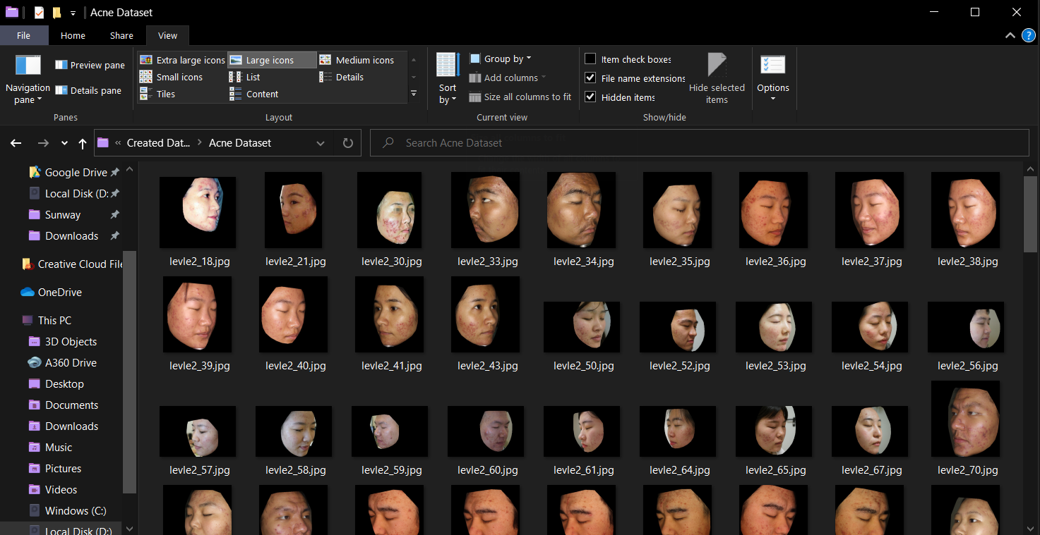
DATA COLLECTION
Acne Classifier
Kaggle
Kaggle, a subsidiary of Google LLC, is an online community of data scientists and machine learning practitioners.
Kaggle allows users to find and publish data sets, explore and build models in a web-based data-science environment, work with other data scientists and machine learning engineers, and enter competitions to solve data science challenges.
Source:https://www.kaggle.com/rutviklathiyateksun/acne-grading-classificationdataset

Slide 10
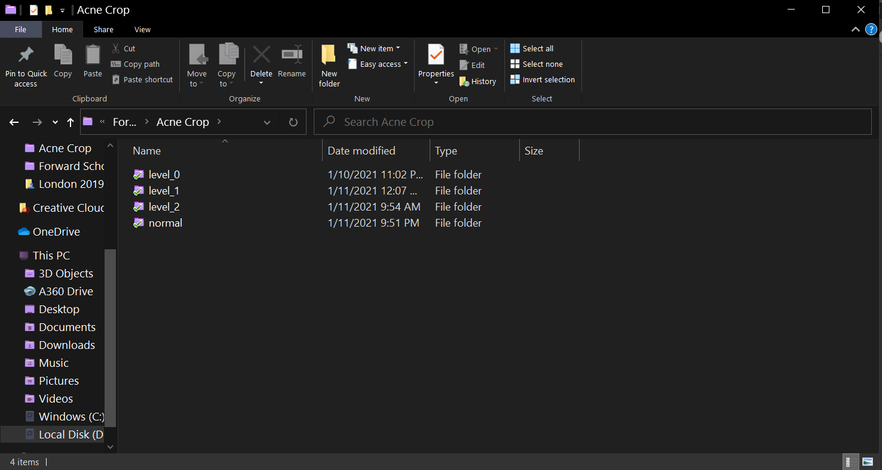
ANNOTATION

Slide 11
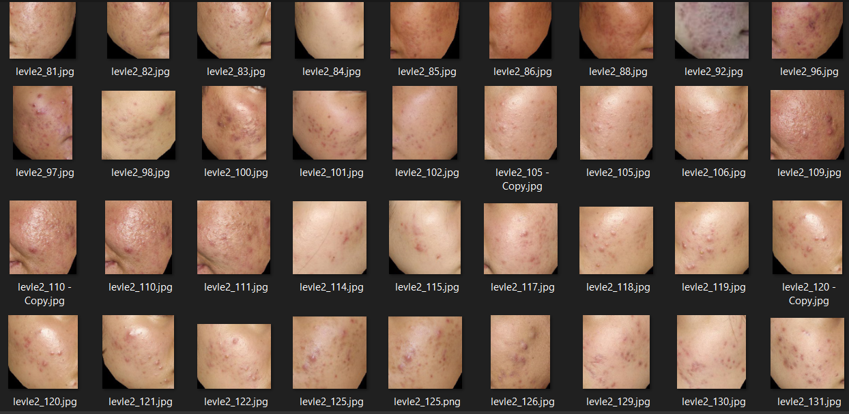
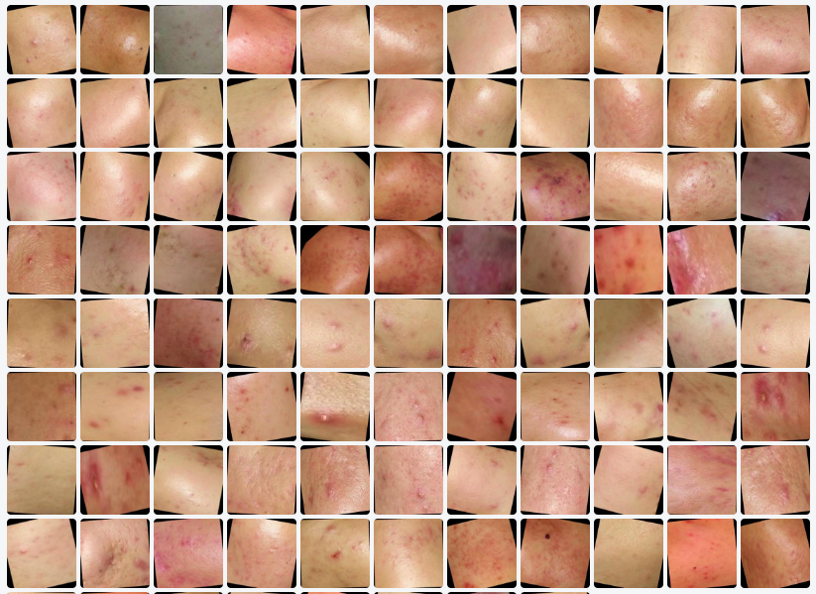
DATA PREPROCESSING
Target Image Cropping Manually to Remove Unwanted Noise (i.e. eyes, nose, mouth)
Flip: Horizontal, Vertical
90° Rotate: Clockwise, Counter-Clockwise, Upside Down
Crop: 0% Minimum Zoom, 50% Maximum Zoom
Rotation: Between -15° and +15°
Blur: Up to 10px
Rotate: 30 degree

Slide 12
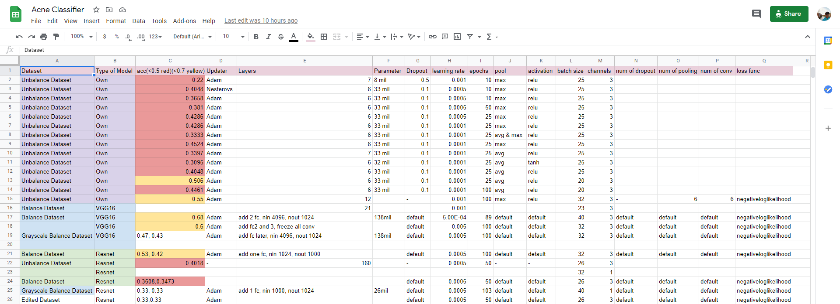
ARCHITECTURE & MODELING
Acne Classifier
We tried to build our own model initially but couldn’t achieve great result. We then tried different architecture and models up to at least 50 times before decided to use Resnet-18. By keeping track of our models, we analyzed that Resnet-32 is the most suitable architecture to be used in this project. We also utilised wandb to fine-tune the weights and bias to achieve maximum accuracy.

Slide 13
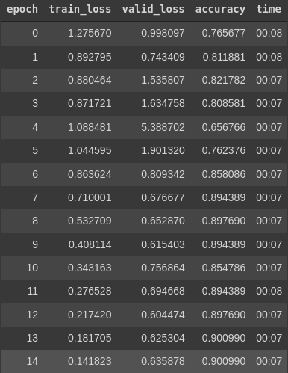
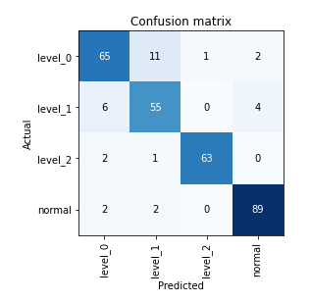
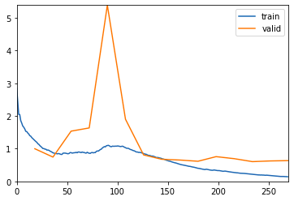
EVALUATION
Acne Classifier
Loss Function
Confusion Matrix
Accuracy
After never-ending training and testing with different models and architecture, we finally achieve the accuracy we wanted which is 90.0%!

Slide 14
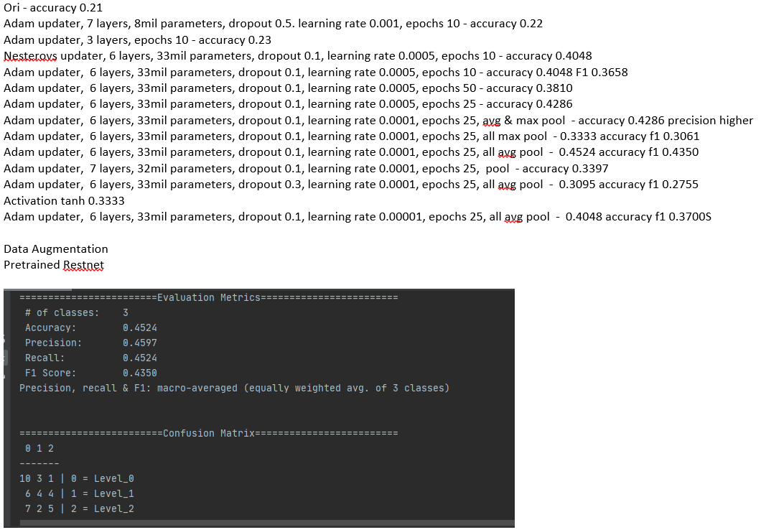
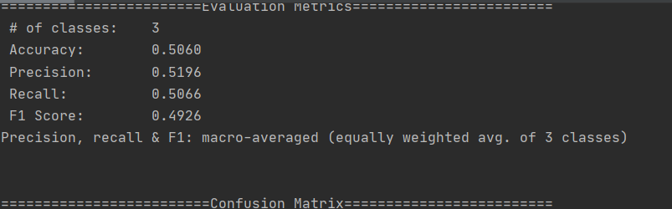
PROBLEM FACED
Underfitting
Using Own Model
Able to Achieve up to 50.6% Accuracy after Tuning for several Weeks

Slide 15
SOLUTION
Use Different Deep Learning Architecture
Using Resnet-18
Able to Achieve 90.00% Accuracy after Fine-Tuning

Slide 16
PROBLEM FACED
Underfitting
High Bias Data
Images contain parts that are not useful

Slide 17
SOLUTION
Image Processing
Crop Acne Area
Remove Unwanted Parts

Slide 18
PROBLEM FACED
Underfitting
High Bias Data
Inconsistent Brightness in Dataset

Slide 19
SOLUTION
Image Processing
Data Augmentation
Pre-processed Data using various Filters

Slide 20
COMPARISON TABLES
Comparing the Acne Classifier with Contemporary Alternative Options
ACNE CLASSIFIER
Free
5 Seconds
Follow Up Anytime
Recommends Best Skin Care Solution (Proposed)
24/7 Support
Virtual Interaction
DERMATOLOGY
$221
2 Hours
Appointment Needed
Recommends Best Skin Care Products & Solution
Working Hours Only
Real Life Interaction
FACIAL TREATMENT
$100
1.5 Hours
Appointment Needed
Recommends Skin Care Products to Gain Profits
Working Hours Only
Real Life Interaction
Best Options
With all this glaring and concrete information available, no one can hide from the fact that our Acne Classifier is the most viable option when compared to current plausible alternatives.

Slide 21
POSSIBLE IMPROVEMENTS
Make into a Smartphone App
A Platform to Discuss about Skin Care Products
By developing the Acne Classifier into a smartphone app, individuals can check their acne condition anytime, anywhere! Individuals can take picture with no filters directly from the mobile app.
Individuals who have tried certain skin care products are able to review and give comments or rating through the platform.
Cross geographical samples
More detailed classifier
One of the limitations now is we have limited resources and we can only classify acne for Asians.
Develop the acne classifier to classify detailed acne problems such as blackhead.
Collaboration with Dermatologists
Higher Accuracy
Individuals can contact dermatologists through this platform to know more details about their skin conditions.
Due to lacking resources and computational power, we can only achieve optimum accuracy. However, higher accuracy can be obtained by enhancing our model.

Slide 22
CONCLUSION
1.To sum up, the acne classifier is able to classify level of seriousness into 4 classes, which are normal, level 0, level 1, and level 2 up to 90% accuracy.
2.Many improvements can be done if given with better quality dataset, higher computational power and more time.

Slide 23
REFERENCES
[1] WebMD. 2022. Teens and Acne. [online] Available at: [Accessed 18 July 2022]. [2] Aad.org. 2022. Skin conditions by the numbers. [online] Available at: [Accessed 18 July 2022].
[2] Aad.org. 2022. Skin conditions by the numbers. [online] Available at: [Accessed 18 July 2022]
[3] Gugger, S., 2022. The 1cycle policy. [online] Another data science student's blog. Available at: [Accessed 18 July 2022].
[4]Pancholi, N., Goel, S., Nijhawan, R., Gupta, S. (2021, December). Classification and Detection of Acne on the Skin using Deep Learning Algorithms. In 2021 19th OITS International Conference on Information Technology (OCIT) (pp. 110-114). IEEE.

Slide 24
Thank You

